Slide 1
COMPUTER PROGRAMMING IN C
UNIT - 1
SESSION - 4

Slide 2

BACKGROUND
The C programming language was designed by Dennis Ritchie at Bell Laboratories in the year 1972s.
Influenced by
ALGOL 60 (1960)
( Algorithmic Language 60)
CPL (Cambridge, 1963),
( Combined Programming Language)
BCPL (Martin Richard, 1967)
( Basic Combined Programming Language)
B (Ken Thompson, 1970)

Slide 3
Characteristics Of C PROGRAMMING LANGUAGE:
C language is the most widely used language in operating systems and embedded system development today.
Easy-to-understand compilation.
It Produces efficient code.
It is a structured programming language.
C supports functions that enables easy maintainability of code, by breaking large files into smaller modules.
C language is reliable, simple and easy to use.

Slide 4
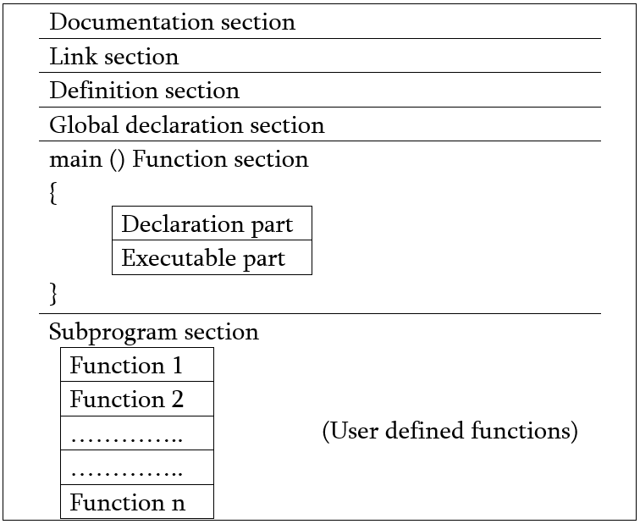
C PROGRAMS - STRUCTURE OF C PROGRAM

Slide 5
STRUCTURE OF C PROGRAM
Documentation section: The documentation section consists of a set of comment lines giving the name of the program, the author and other details, which the programmer would like to use later.
Ex : /*
* Name: Sample Program
* Author: OnlineClassNotes.COM
* Create Date: 26/11/2016
* Last Modified: 27/11/2016
*/
Single line comment (//)

Slide 6
STRUCTURE OF C PROGRAM
2. Link section: The link section provides instructions to the compiler to link functions from the system library such as using the
#include directive.
Ex : #include <stdio.h>
3. Definition section: The definition section defines all symbolic constants such using the #define directive.
Ex : # define pi 3.14

Slide 7
STRUCTURE OF C PROGRAM
4. Global declaration section: There are some variables that are used in more than one function. Such variables are called global variables and are declared in the global declaration section that is outside of all the functions. This section also declares all the user-defined functions.
Ex : float addNumbers(float a, float b);

Slide 8
STRUCTURE OF C PROGRAM
5. main () function section: Every C program must have one main function section. This section contains two parts: declaration part and executable part
Declaration part: The declaration part declares all the variables used in the executable part.
Executable part: There is at least one statement in the executable part.
These two parts must appear between the opening and closing braces. The program execution begins at the opening brace and ends at the closing brace. The closing brace of the main function is the logical end of the program. All statements in the declaration and executable part end with a semicolon.
It is known as Statement Separator.
Ex : main() { int a = 5, b = 6;
Sum = a + b;
}

Slide 9
STRUCTURE OF C PROGRAM
6. Subprogram section: If the program is a multi-function program then the subprogram section contains all the user-defined functions that are called in the main () function. User-defined functions are generally placed immediately after the main () function, although they may appear in any order.
Ex : float addNumbers(float a, float b)
{
return (a+b);
}

Slide 10
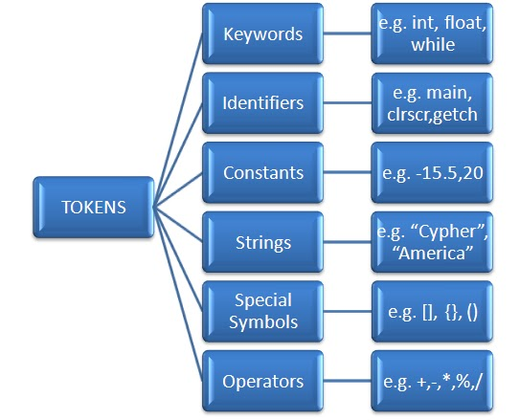
C Tokens
In a passage of text, individual words and punctuation marks are called tokens or lexical units.
Similarly, the smallest individual unit in a c program is known as a token or a lexical unit.
C tokens can be classified as follows:

Slide 11
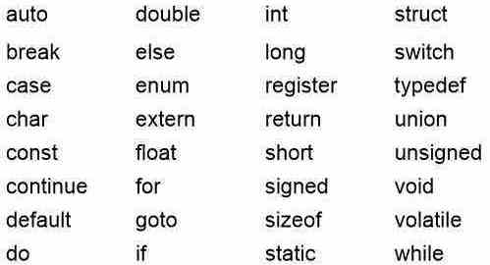
Keywords
C keywords are the words that convey a special meaning to the c compiler.
These are reserved or predefined words existed in C - library.These are acting as building blocks of a program.
And which cannot be changed by the user. Total 32 keywords are available and all should be in lowercase only.
The list of C keywords is given below:

Slide 12
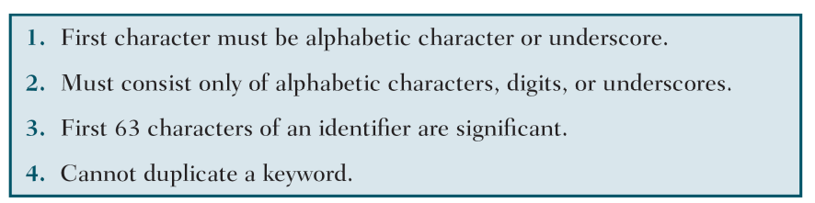
IDENTIFIERS
One feature present in all computer languages is the identifier. Identifiers allow us to name data and other objects in the program. Each identified object in the computer is stored at a unique address.
An Identifier is a sequence of letters and digits, but must start with a letter. Underscore ( _ ) is treated as a letter. Identifiers are case sensitive. Identifiers are used to name variables, functions etc.

Slide 13
IDENTIFIERS
It may not have a space or a hyphen.
C is a case-sensitive language.
Punctuation and special characters aren’t allowed except underscore.
Ex : int money; double accountBalance;
Here, money and accountBalance are identifiers.

Slide 14
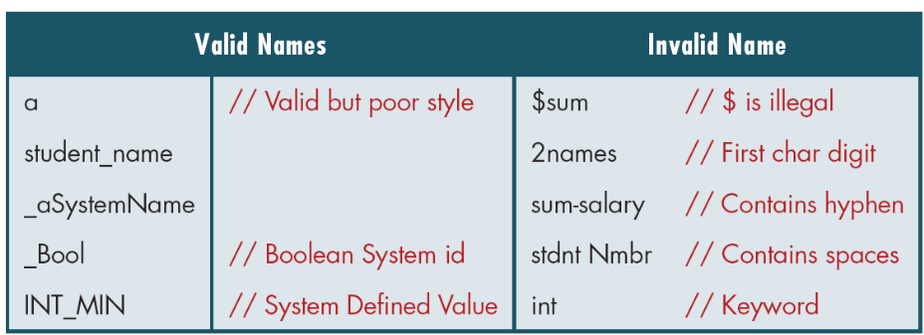
Examples of Valid and Invalid Names

